Slide 1


FITNESS
APP
BASAVARAJ PATIL
SAURAV SINGH
BHUVAN RAJ
ROHIT
RAHUL
BOYUAN YE
MALAV BHAT
REVANTH

Slide 2

OUR PROJECT
For normal user
Login & Signup & Log out
Select & Remove Daily exercise
Editing Profile
For Administrator
Login & Log out
Manage Exercise List
Manage User List
Also
Different pages display for different roles

Slide 3

CONTRIBUTIONS
BASAVARAJ PATIL
WORKED ON CONTROLLER AND SERVICES CLASSES
BHUVAN RAJ
WORKED ON BACKEND CREATED MAPPER AND SERVICE CLASSES. CREATED LOGIN AND SIGNUP PAGE
SAURAV SINGH
WORKED ON BACKEND CREATED CONTROLLER AND SERVICE CLASS
RAHUL POTHIRENDI
WORKED ON DATABASE , CREATED MAPPER PACKAGES TO CREATE SUBCLASSES FOR CONNECTION
ROHIT VARMA
WORKED ON DATABASE AND UI IMPLEMENTATIONS
MALAV BHATT
WORKED ON DATABASE , CREATED MAPPER PACKAGES TO CREATE SUBCLASSES FOR CONNECTION
ERIK BOYUAN YE
WORKED ON BACKEND AND FRONTEND IMPLEMENTATIONS
REVANTH
WORKED ON DATABASE , CREATED MAPPER PACKAGES TO CREATE SUBCLASSES FOR CONNECTION

Slide 4
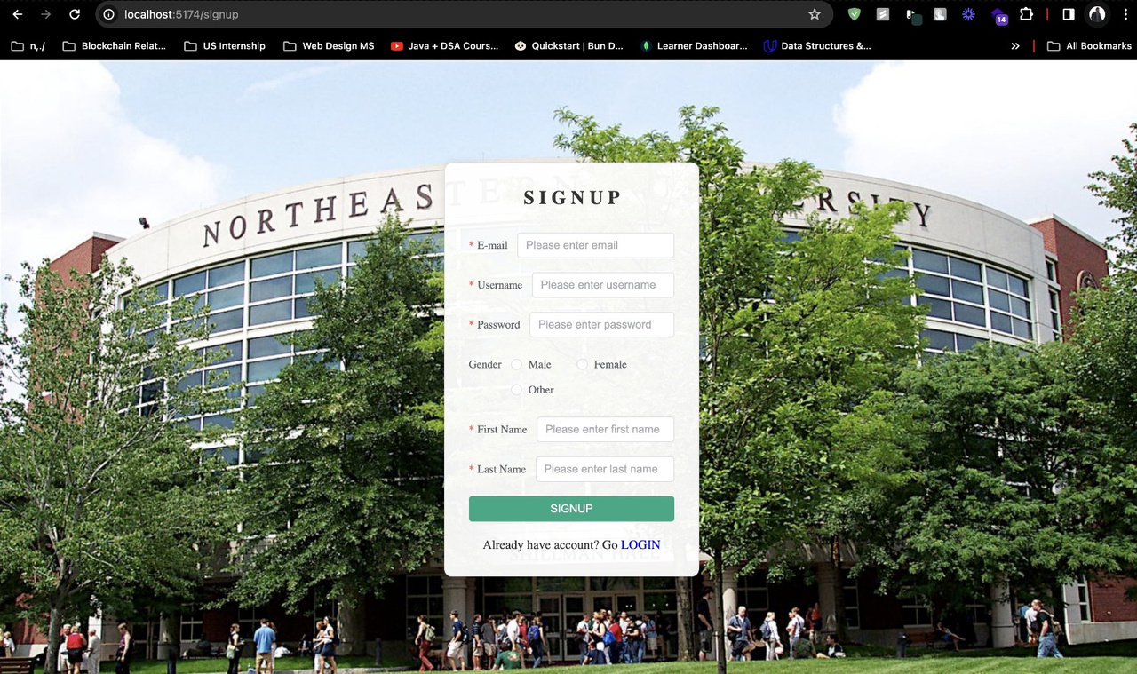
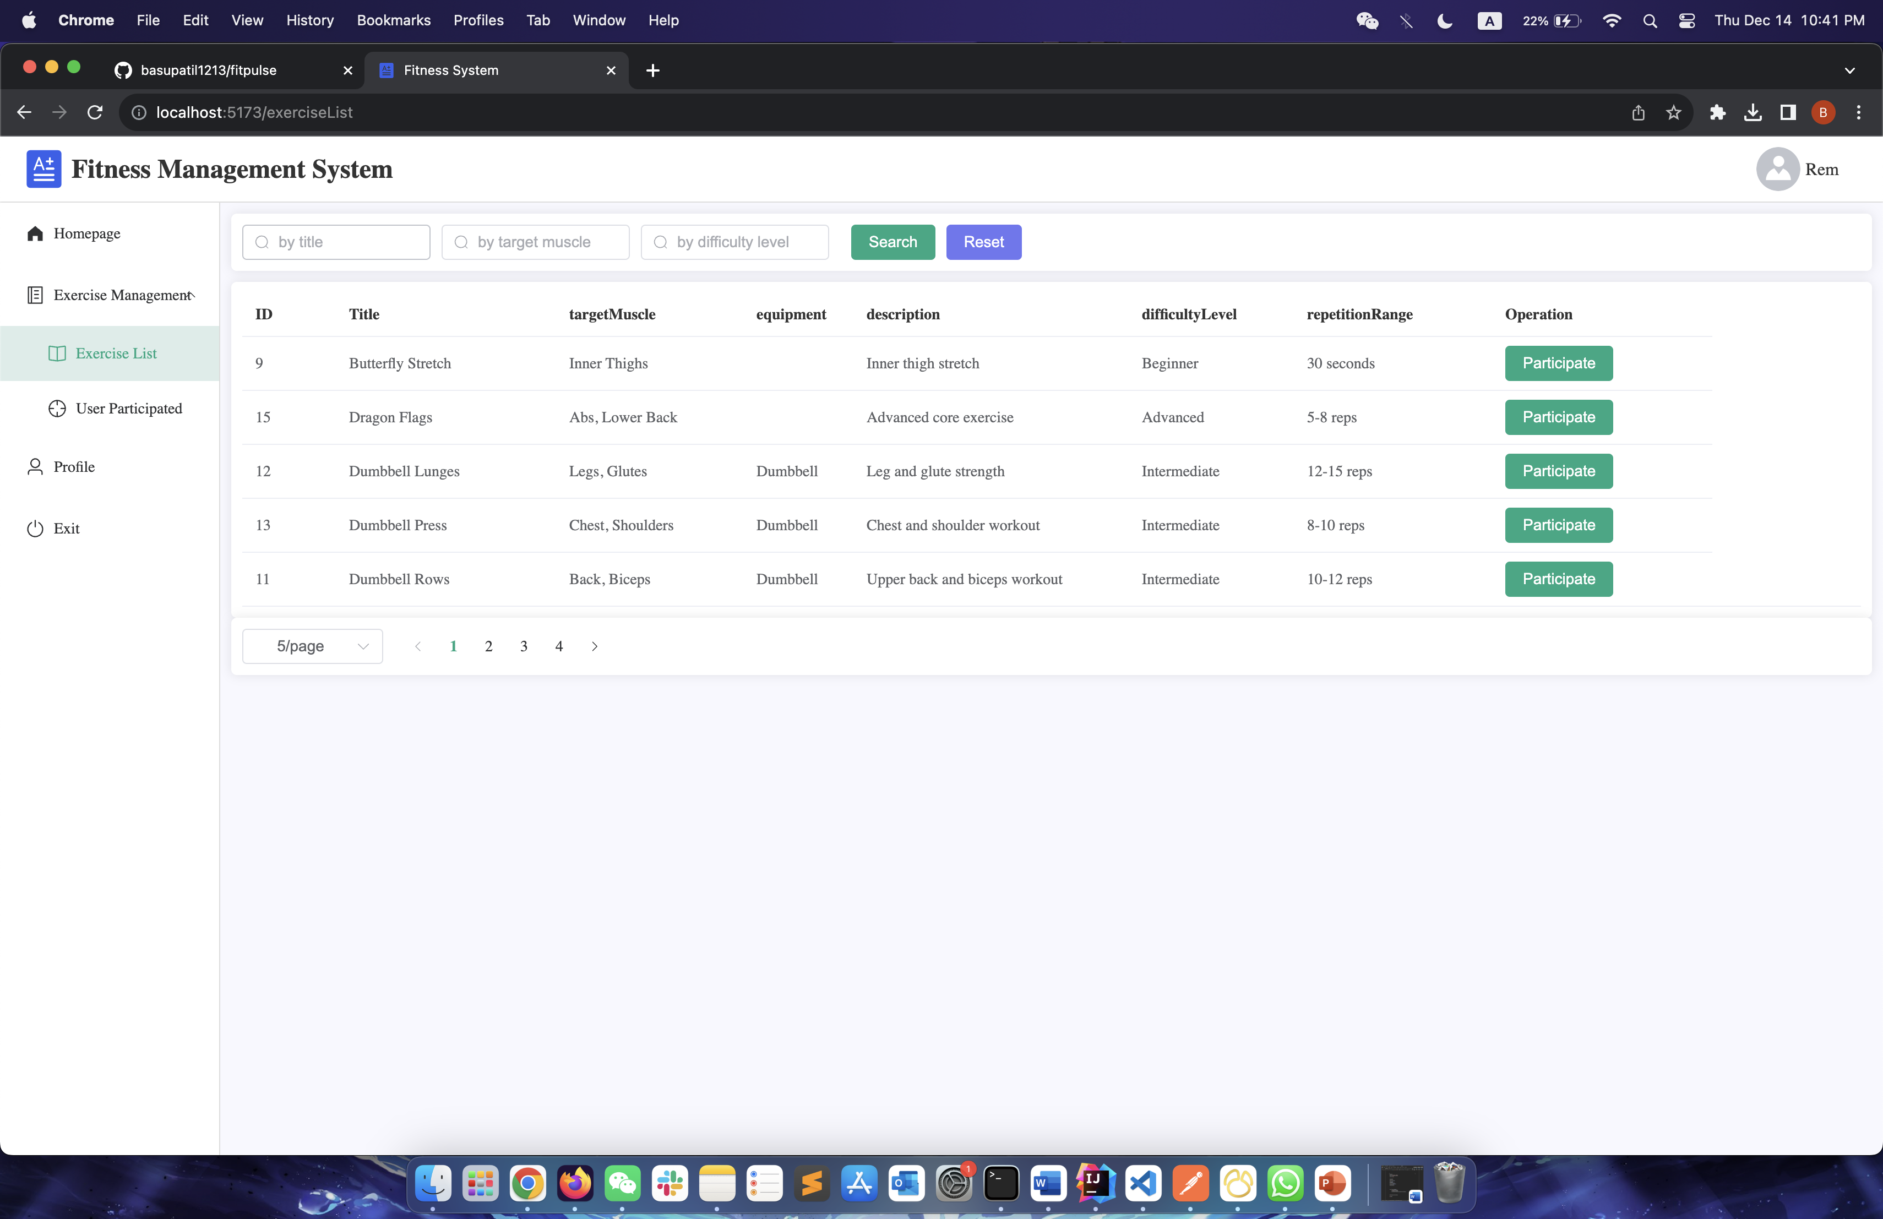
USER-CENTRIC DESIGN

Slide 5





TECH STACK

Slide 6
OUR CODE
Data Store: Relational Database
User Friendly UI: Vue3 + html+ css + js
Well-Structured Backend: Springboot
Also,
Clean code, easy to understand
SOLID & OOD, data protected, low coupling
MVC Model: well-structured, reusable, maintainable

Slide 7
CONCLUSION
Fitness App stands as a testament to the seamless integration of Java Spring Boot for a robust backend and HTML, CSS, and JavaScript for an engaging frontend. The application not only tracks fitness but also provides a personalized and interactive experience, making it a go-to choice for individuals committed to their health and wellness journey.

